Slide 1
CSE 601: Distributed Systems
Toukir Ahammed

Slide 2
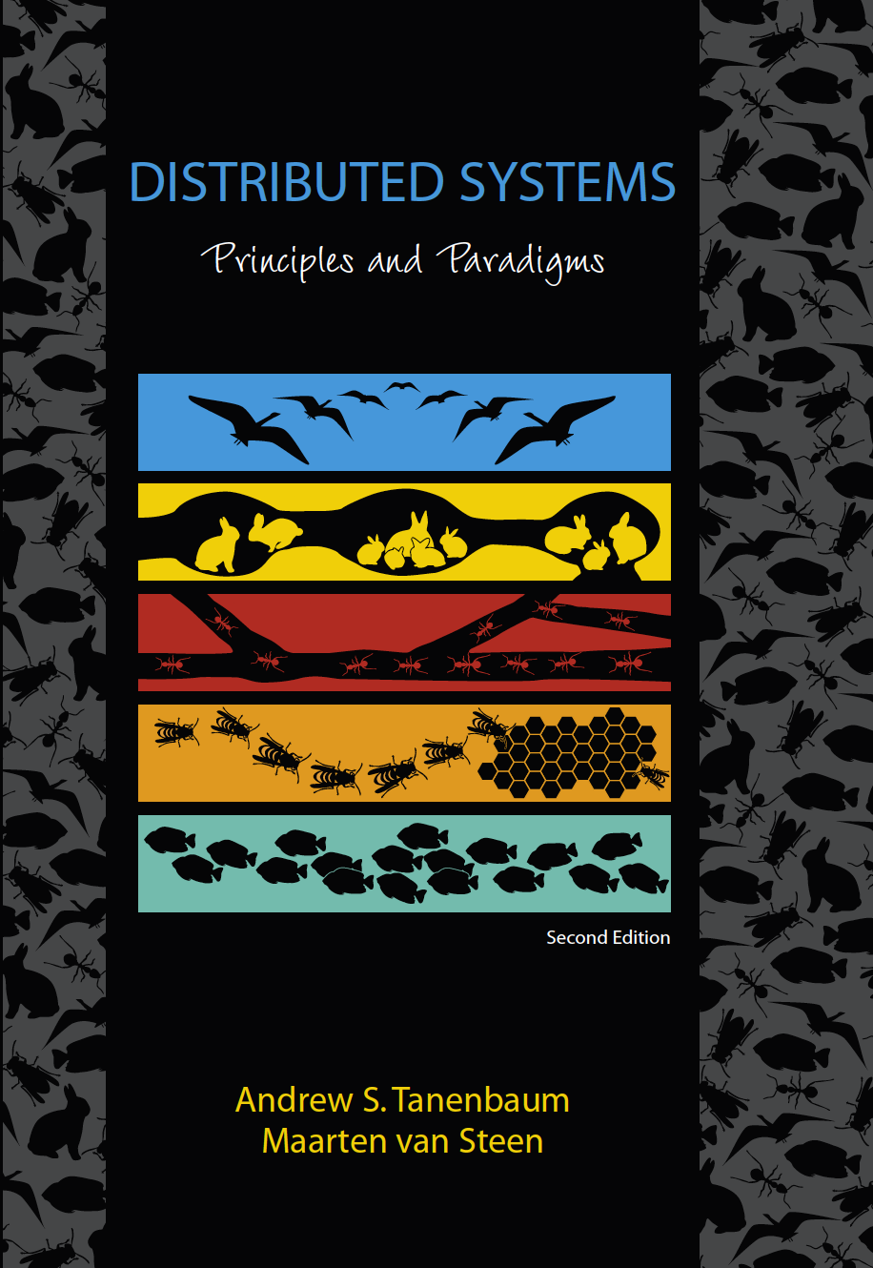
Course Overview
Course Title: Distributed Systems
Course Code: CSE601
Credit: 3 Credits (2 Credit Theory + 1 Credit Lab)
Reference Book:
Distributed systems: Principles and Paradigms by Andrew S. Tanenbaum (2nd edition)

Slide 3
Marks Distribution
Attendance 5
Midterm 15
Presentation 5
Lab/Project 25
Assignment 20
Final Exam 30

Slide 4
Google Classroom
p44adob

Slide 5
Introduction to Distributed System

Slide 6
Definition of a Distributed System
A distributed system is:
“A collection of independent computers that appears to its users as a single coherent system.”
“A computing environment in which various components are spread across multiple nodes (computer, phone, car, robot or other computing devices) on a network trying to achieve some task together.”

Slide 7
Examples of distributed systems
Machine learning (for compute)
P2P file sharing (high availability, share large files, piracy)
Google search engine (for storage and bandwidth)
Facebook (for storage and bandwidth)
Black hole image (distributed observation)
IOT (Sensors on a network)
Blockchain (decentralized record of transactions) etc.

Slide 8
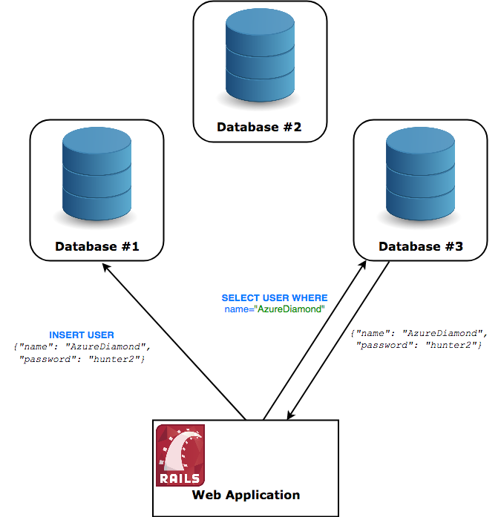
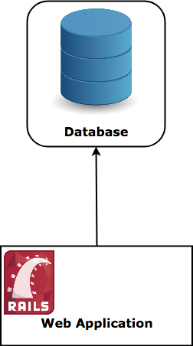
Example
An architecture that can be considered distributed
A traditional stack

Slide 9
Distributed versus decentralized systems
centralized
decentralized
distributed

Slide 10
Distributed versus decentralized systems
Decentralized is still distributed in the technical sense, but the whole decentralized systems is not owned by one actor. No one company can own a decentralized system, otherwise it wouldn’t be decentralized anymore.
This means that most systems we will go over today can be thought of as distributed centralized systems — and that is what they’re made to be.

Slide 11
Why make a system distributed?
It’s inherently distributed:
e.g. sending a message from your mobile phone to your friend’s phone
For better reliability:
even if one node fails, the system as a whole keeps functioning
For better performance:
get data from a nearby node rather than one halfway round the world
To solve bigger problems:
e.g. huge amounts of data, can’t fit on one machine

Slide 12
Advantages of Distributed Systems
Scalability: Distributed systems are made on default to be scalable. Whenever there is an increase in workload, users can add more workstations. There is no need to upgrade a single system. Moreover, no any restrictions are placed on the number of machines.
Reliability: Distributed systems are far more reliable than single systems in terms of failures. Even in the case of a single node malfunctioning, it does not pose problems to the remaining servers. Other nodes can continue to function fine.

Slide 13
Advantages of Distributed Systems
Low Latency: Since users can have a node in multiple geographical locations, distributed systems allow the traffic to hit a node that’s closest, resulting in low latency and better performance.
Efficiency: Distributed systems allow breaking complex problems/data into smaller pieces and have multiple computers work on them in parallel, which can help cut down on the time needed to solve/compute those problems.

Slide 14
Why NOT make a system distributed?
The trouble with distributed systems:
Communication may fail (and we might not even know it has failed).
Processes may crash (and we might not know).
All of this may happen non-deterministically.
Fault tolerance: we want the system as a whole to continue working, even when some parts are faulty.
This is hard.
Writing a program to run on a single computer is comparatively easy?!

Slide 15
Challenges of Distributed Systems
Heterogeneity (variety and difference): the differences that arise in networks, programming languages, hardware, operating systems and differences in software implementation.
Openness: the system's extensibility and ability to be reimplemented. It can be measured by 3 characteristics:
interoperability: system's ability to effectively interchange information between computers by standardization
portability: system's ability to properly function on different operating systems
extensibility: allowing developers to freely add new features or easily reimplement existing ones without impairing functionality

Slide 16
Challenges of Distributed Systems
Security: consists of 3 components
confidentiality: protection against disclosure to unauthorized individuals
integrity: protection against alteration or corruption
availability: protection against interference with the means to access the resources.
Concurrency: multiple clients can access a shared resource at the same time. Thus, steps need to be taken to ensure that any manipulation in the system remains in a stable state. However, the illusion of simultaneous execution should be preserved.

Slide 17
Challenges of Distributed Systems
Scalability: the measure of a system’s ability to increase or decrease in performance and cost in response to changes in application and system processing demands.
Example: how well a hardware system performs when the number of users is increased, how well a database withstands growing numbers of queries, or how well an operating system performs on different classes of hardware.
Failure handling: When faults occur, programs may produce incorrect results or may stop before they have completed the intended computation. Any process, computer or network may fail independently of the others. Therefore each component needs to be aware of the possible ways in which the components it depends on may fail and be designed to deal with each of those failures appropriately.

Slide 18
Challenges of Distributed Systems
Transparency: system that is able to present itself to users and applications as if it were only a single computer system is said to be transparent.
Transparency | Description
Access | Hide differences in data representation and how an object is accessed
Location | Hide where an object is located
Relocation | Hide that an object may be moved to another location while in use
Migration | Hide that an object may move to another location
Replication | Hide that an object is replicated
Concurrency | Hide that an object may be shared by several independent users
Failure | Hide the failure and recovery of an object

Slide 19
Design Goals of a Distributed Systems
Resource Sharing

Slide 20
Making Resource Accessible
An important goal of a distributed system is to make it easy for users (and applications) to access and share remote resources.
Example: printers, computers, storage facilities, data, files, services, networks etc.
Economic reason: it makes economic sense to share costly resources such as supercomputers, high-performance storage systems, e.g., it is cheaper to
have a single high-end reliable storage facility be shared than having to buy and maintain storage for each user separately.
it is cheaper to let a printer be shared by several users in an office than having to buy and maintain a separate printer for each user

Slide 21
Making Resource Accessible
More advantages
Connecting users and resources also makes it easier to collaborate and exchange information
collaboration tools such as software for collaborative editing, teleconferencing, and so on that became (more easily) available due to the COVID-19 pandemic

Slide 22
Design Goals of a Distributed Systems
Distribution transparency

Slide 23
Distribution transparency
An important goal of a distributed system is to hide the fact that its processes and resources are physically distributed across multiple computers, possibly separated by large distances.
In other words, it tries to make the distribution of processes and resources transparent, that is, invisible, to end users and applications.

Slide 24
Types of distribution transparency
Transparency | Description
Access | Hide differences in data representation and how an object is accessed
Location | Hide where an object is located
Relocation | Hide that an object may be moved to another location while in use
Migration | Hide that an object may move to another location
Replication | Hide that an object is replicated
Concurrency | Hide that an object may be shared by several independent users
Failure | Hide the failure and recovery of an object

Slide 25
Access Transparency
Access transparency deals with hiding differences in data representation and the way that objects can be accessed.
Example:
A distributed system may have computer systems that run different operating systems, each having their own file-naming conventions.
Access issues that should preferably be hidden:
differences in naming conventions
differences in file operations, or
differences in low-level communication with other processes

Slide 26
Location Transparency
Location transparency refers to the fact that users cannot tell where an object is physically located in the system.
Naming plays an important role in achieving location transparency. It can often be achieved by assigning only logical names to resources, i.e., names in which the location of a resource is not secretly encoded.
Example: uniform resource locator (URL) such as https://www.distributed-systems.net/, gives no clue about the actual location of the Web server

Slide 27
Migration Transparency
Distributed systems in which resources can be moved without affecting how those resources can be accessed are said to provide migration transparency.
In the previous example, the URL also gives no clue whether files at that site have always been at their current location or were recently moved there.

Slide 28
Relocation Transparency
Relocation transparency supports the mobility of processes and resources initiated by users, without affecting ongoing communication and operations. In such cases, resources can be relocated while they are being accessed without the user or application noticing anything
Example:
communication between mobile phones: regardless whether two people are actually moving, mobile phones will allow them to continue their conversation.
online tracking and tracing of goods as they are being transported from one place to another

Slide 29
Replication Transparency
In distributed systems, resources may be replicated to increase availability or to improve performance by placing a copy close to the place where it is accessed.
Replication transparency deals with hiding the fact that several copies of a resource exist, or that several processes are operating so that one can take over when another fails.
Note: a system that supports replication transparency should generally support location transparency as well, because it would otherwise be impossible to refer to replicas at different locations.

Slide 30
Concurrency Transparency
An important goal of distributed systems is to allow sharing of resources. In many cases, sharing resources is done cooperatively. However, there are also many examples of competitive sharing of resources.
Example: two independent users may each have stored their files on the same file server or may be accessing the same tables in a shared database. In such cases, it is important that each user does not notice that the other is making use of the same resource. This phenomenon is called concurrency transparency.
An important issue of concurrent access is the consistency of the resource. It can be achieved through locking mechanisms, by which users are given exclusive access to the desired resource.

Slide 31
Failure Transparency
Failure transparency means that a user or application does not notice that some piece of the system fails to work properly, and that the system subsequently (and automatically) recovers from that failure.
Masking failures is one of the hardest issues in distributed systems and is even impossible in certain cases. The main difficulty in masking and transparently recovering from failures lies in the inability to distinguish between a dead process and a painfully slowly responding one.
Example: when contacting a busy Web server, a browser will eventually time out and report that the Web page is unavailable. At that point, the user cannot tell whether the server is actually down or that the network is badly congested.

Slide 32
Design Goals of a Distributed Systems
Openness

Slide 33
Openness
Another important goal of distributed systems is openness.
An open distributed system is essentially a system that offers components that can easily be used by, or integrated into other systems.
At the same time, an open distributed system itself will often consist of components that originate from elsewhere.

Slide 34
Openness: Interoperability
Interoperability characterizes the extent by which two implementations of systems or components from different manufacturers can co-exist and work together by merely relying on each other’s services as specified by a common standard.
Example: a healthcare system where hospitals and clinics, using different software platforms, exchange patient data seamlessly through open standards

Slide 35
Openness: Portability
Portability characterizes to what extent an application developed for a distributed system A can be executed, without modification, on a different distributed system B that implements the same interfaces as A.
Example: cloud-based application that can be easily moved from one cloud provider, like AWS, to another, such as Google Cloud, without significant modification (containerization technologies like Docker)

Slide 36
Openness: Extensibility
It should be easy to add new components or replace existing ones without affecting those components that stay in place. In other words, an open distributed system should also be extensible.
In an extensible system, it should be relatively easy to add parts that run on a different operating system, or even to replace an entire file system.
Example: plug-ins for Web browsers, but also those for Websites, such as the ones used for WordPress.

Slide 37
Design Goals of a Distributed Systems
Scalability

Slide 38
Scalability dimensions
Size scalability: A system can be scalable regarding its size, meaning that we can easily add more users and resources to the system without any noticeable loss of performance.
Geographical scalability: A geographically scalable system is one in which the users and resources may lie far apart, but the fact that communication delays may be significant is hardly noticed.
Administrative scalability: An administratively scalable system is one that can still be easily managed even if it spans many independent administrative organizations.

Slide 39
Size Scalability
The computational capacity, limited by the CPUs
Example:
A service for computing optimal routes taking real-time traffic information into account
Problems:
this may be primarily a compute-bound service, requiring several (tens of) seconds to complete a request
if there is only a single machine available, then even a modern high-end system will eventually run into problems when the number of requests increases beyond a certain point

Slide 40
Size Scalability
The storage capacity, including the I/O transfer rate
Example:
a poorly designed centralized search engine
Problems:
need to match a query against an entire data set
huge amount of data can exceed the main-memory capacity
much of the processing time will be determined by the relatively slow disk accesses and transfer of data between disk and main memory

Slide 41
Size Scalability
The network between the user and the centralized service
Example:
a video-on-demand service that needs to stream high-quality video to multiple users
Problems:
a video stream can easily require a bandwidth of 8 to 10
if a service sets up point-to-point connections with its customers, it may soon hit the limits of the network capacity

Slide 42
Geographical Scalability
many of distributed systems designed for local-area networks are based on synchronous communication
in a wide-area system, we need to consider that inter-process communication may be hundreds of milliseconds
Example:
Streaming video: In a home network, even with wireless links, ensuring a stable, fast stream of high-quality video frames from a media server to a display is quite simple.
Simply placing that same server far away will surely fail: bandwidth limitations will instantly surface

Slide 43
Administrative Scalability
The concern is how to scale a distributed system across multiple, independent administrative domains
A major problem that needs to be solved is that of conflicting policies regarding resource usage (and payment), management, and security
a distributed system that reside within a single domain can often be trusted by users
system administration may have tested and certified applications, and may have taken special measures to ensure that such components cannot be tampered with

Slide 44
Administrative Scalability
If a distributed system expands to another domain, two types of security measures need to be taken
has to protect itself against malicious attacks from the new domain
Users from the new domain may have only read access to the file system
facilities may not be made available to unauthorized users
has to protect itself against malicious attacks from the distributed system
Counterexample: some distributed systems spanning multiple administrative domains that apparently do not suffer from administrative scalability problems (e.g., modern file-sharing peer-to-peer networks)

